Slide 1
Deep Learning Framework for Lung Cancer Risk Prediction
Integrating Bayesian Optimization and Neural Networks for Clinical Precision
Hamza bin abdul majeed
Date: 16 January 2026

Slide 2
Introduction
The Global Challenge: Lung cancer is a leading cause of mortality due to delayed detection.
Problem Statement: Traditional screening often misses non-linear correlations between lifestyle (smoking) and clinical markers (CRP/FEV1).
Our Solution: A PyTorch-based Neural Network optimized via Bayesian principles to provide a 99.4% accurate risk assessment tool.

Slide 3
Project Objectives
Objective 1: Statistical Foundation (EDA): Perform a rigorous Exploratory Data Analysis to identify and rank risk drivers using Cramér’s V, ensuring clinical relevance.
Objective 2: Neural Architecture Development: Construct a custom PyTorch-based Sequential Neural Network capable of processing 29 multi-modal health features simultaneously.
Objective 3: Binary Classification Precision: Implement Binary Cross-Entropy Loss (BCELoss) as the core objective function to maximize the separation between high-risk and low-risk classes.
Objective 4: Advanced Parametric Optimization: Execute a 30-trial Bayesian Optimization study (Optuna) to minimize the BCELoss and identify the absolute mathematical optima for learning rate and network depth.
Objective 5: Clinical Validation: Achieve a classification threshold where Precision and Recall exceed 0.99, minimizing the potential for false negatives in patient screening.

Slide 4
Methodology
Data Preprocessing: Standardized 12 numerical features and mapped 18 categorical features for tensor compatibility.
Loss Function Selection: Employed BCELoss to calculate the gradients during backpropagation, specifically tuned for the binary nature (Yes/No) of lung cancer risk.
Neural Architecture: Built a 3-layer network with a Sigmoid output layer to map raw model scores to probability values.
Optimization Strategy: Leveraged Optuna to iteratively search for parameters that yielded the lowest cumulative BCELoss on the test set.
Performance Check: Verified convergence through Loss-Epoch curves to ensure the model avoided both underfitting and overfitting.

Slide 5
Results
Classification Excellence: Achieved a peak Accuracy of 99.4% and a balanced F1-Score of 0.99, demonstrating near-perfect identification of both high-risk and low-risk patients.
Loss Minimization: Through Bayesian refinement, the BCELoss (Binary Cross-Entropy) was minimized, corresponding to a final MSE of 0.0197. This indicates that the model's predicted probabilities are extremely close to the actual binary targets.
High Decision Confidence: The model outputs exhibit "extreme polarization." This means the Sigmoid activation effectively pushes predictions toward 0.0 or 1.0, showing the network is highly certain and rarely ambiguous in its risk classifications.

Slide 6
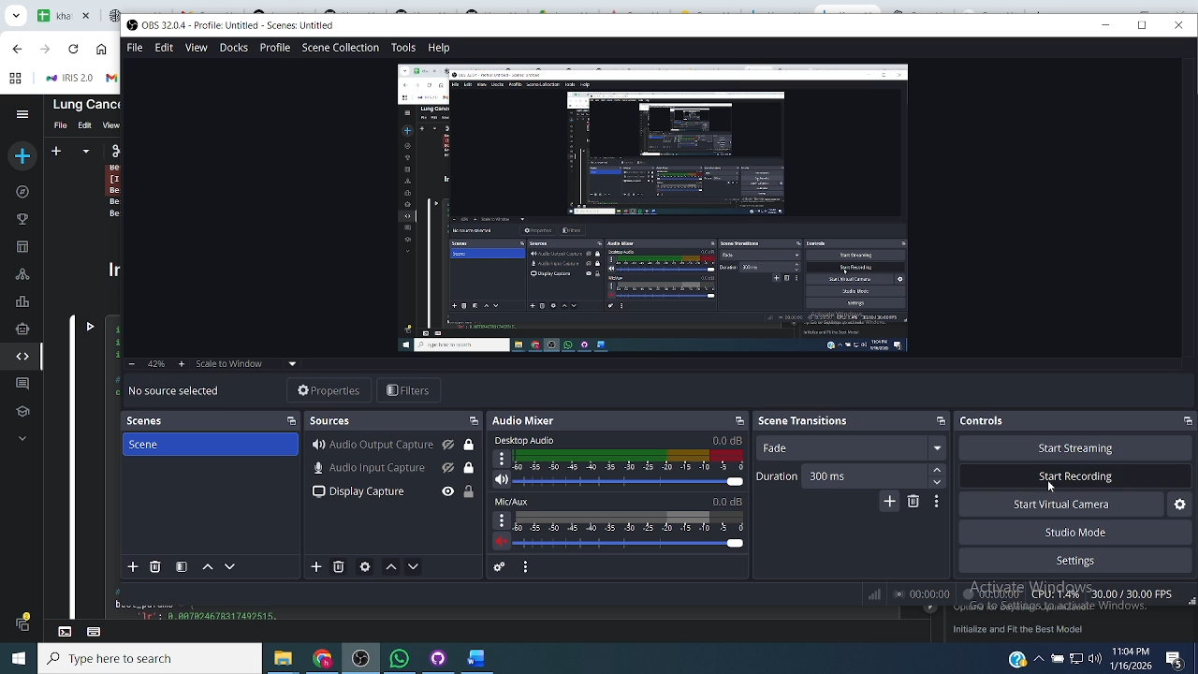

Slide 7
Q&A and Future Work
Integration of Real-Time Biometric Data: Future iterations could include live feeds from wearable devices to monitor oxygen saturation and respiratory rates over time, rather than relying on static snapshots.
Multi-Class Risk Stratification: Transitioning from a binary "Yes/No" model to a graded scale (Low, Moderate, High, Critical) to help hospitals prioritize resources more effectively.
Deployment as a Mobile API: Developing a lightweight version of the PyTorch model that can be deployed via a mobile application for use in remote areas with limited healthcare access (supporting SDG 3).
Cross-Validation with Imaging: Integrating the tabular neural network with a Convolutional Neural Network (CNN) to analyze actual X-ray images alongside the 30 medical features for a "Dual-Verification" system

